Slide 1
Payroll Interface Training
Conference ID: 3 357 828 830
US & Any Country - Toll Call: +1-615-882-6682
US & Canada - Toll-free: +1-844-882-6682
Other local & International Numbers https://dialin.deloitte.com/
Host: Dan Fieldhouse - dfieldhouse@deloitte.com
1
Notes:
Third-Party Payroll Connectors allow you to manage payroll-related Human Resources data and send it to a third-party payroll provider. Worker synchronization, data changes, and worker events relevant to the payment process are configured so that appropriate next steps can be taken in the payroll system.
The advantage of these connectors is the relative ease-of-use and full set of integration features that require no custom code (though the interface is extensible if needed). With change detection built-in, the connector is configured by simply selecting which data and events are required by the accepting payroll system. The interface is pre-tested and supported by Workday, which means less development and testing for your implementation, reduced maintenance costs and risks to the project.

Slide 2
Cloud Connect for Third-Party Payroll Training
Agenda
Day 1 Overview Payroll Interface Setup Payroll Interface Example
Day 2 Staffing Events & Change Detection Functional Changes & PI
Day 3 Payroll Effective Change Interface (PECI) Functional Changes & PECI
Day 4 / Day 5 (if needed) Comparing PI to PECI Transformation & Delivery Wrap Up
Notes:
Course Overview

Slide 3
PECI – Payroll Effective Change Interface

Slide 4
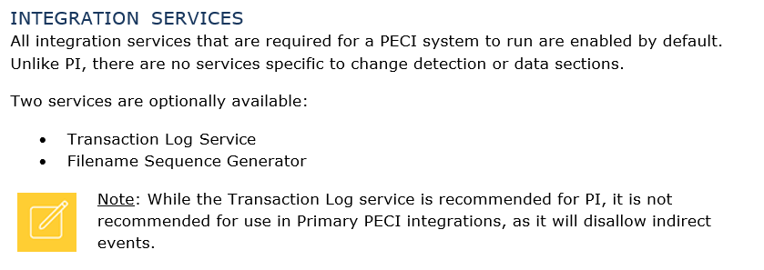
Payroll Effective Change Interface Setup
The Payroll Effective Change Interface template is similar to the Payroll Interface template, but varies slightly in configuration requirements. Similar to PI, any required attributes must be configured and field attributes much be defined in order for change detection to be applied to those fields. Key points regarding integration services, attributes, and field attributes are defined below.
Custom Integration Services can be created to include custom fields in the integration.
Notes:
updated

Slide 5
PECI Attributes
INTEGRATION ATTRIBUTES
PECI requires the Payroll Vendor, Payroll Country, and Document Retention Policy attributes to be configured in order for the integration to successfully launch. Note that Payroll Vendor and Country are used for reporting purposes only and don’t impact the format of the XML output.
Notes:
updated

Slide 6
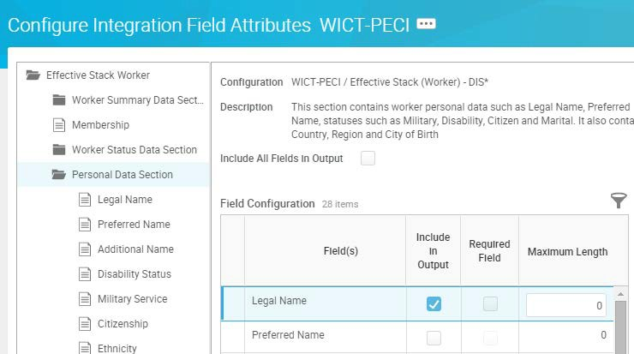
PECI Field Attributes
Configure which fields to include in the output using the PECI system’s Related Actions: Configure Integration Field Attributes. This task is organized using a tree structure with the Effective Stack Worker folder as the top most level.
Within this level, you must specify the data sections to include in the output. Some data sections are included by default, such as Worker Status Data Section.
Notes:
updated

Slide 7
PECI GRID Setup
PECI integrations can only run on a tenant that is grid-enabled. Adding grid to a tenant means that a different environmental configuration is provided for that specific tenant to make large payroll calculations run more quickly.
Grid will not be provided in GMS and AMU tenants.
Number of Grid Tenants
Only one active Implementation or Implementation Preview tenant can be grid enabled at a time. If you have submitted a request to enable a grid tenant, then it will not allow you to enter in a second request to enable grid in a second tenant.
For a deployment to be considered for a second Grid enabled tenant, the EM/PM will need to submit a General Request Tenant Management case with a valid business case along and a tenant management plan that demonstrates an inability to deliver with only one Grid enabled tenant. If approved, the duration of Grid on that second tenant will have a limited window. Here are the reasons that warrant a second Grid enabled tenant:
PECI - Overlapping PECI Implementation that must use its own tenant
Payroll - A second Grid will be provided to customers for a limited duration for implementations that require Payroll performance testing
Miscellaneous - A simultaneous deployment with competing test plans such as Financials or Payroll or PECI
https://community.workday.com/articles/85909
Notes:
updated

Slide 8
PECI Launch Parameters
Launch Parameters for PECI are enabled by default with the Payroll Effective Change Interface – Launch Parameters Integration Service. This service is not optional. Several parameters are the same as PI, but some are new, used in place of Integration Attributes.
The available launch parameters are:
Field | Description
PAY GROUP | Groups of employees who are paid the same way.
 | Select one or more pay groups at the prompt to extract pay period data for all pay group members.
PAY PERIOD SELECTION OPTION | The Pay Period is the date range employees are paid. Specify the method for determining the Pay Period:
 | • Use Earliest Open Pay Period: Selects the first open pay period based on the pay group's period schedule and period calculation status.
 | • Use Pay Period for Current Date: Select the pay period for the current date.
PRIMARY RUN | Select this box to run the integration as Primary. Only the Pay Group and Pay Period Selection Option launch parameters will be applied.
PAY GROUP MEMBERS | Select specific members from the Pay Group defined.
EXCLUDE MEMBERS / ONLY INCLUDE MEMBERS | Use in conjunction with Pay Group Members to either exclude or include the specified members.
CHANGE DETECTION | Use for ad-hoc runs to define the change detection method, either:
 | • Include all changes effective in the pay period
 | • Include only changes entered since the last successful run
FULL SNAPSHOT | Select this box to generate a full file of payee data effective as of the last day of the pay period. This setting cannot be applied when Primary Run is enabled.
LAST SUCCESSFUL RUN DATE | Manually set the date of the last successful integration run or allow it to default automatically. Primary integrations will save the LSRD and apply to for each pay group.
Notes:
updated

Slide 9
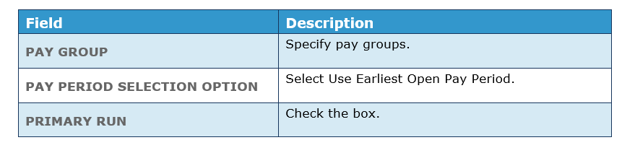
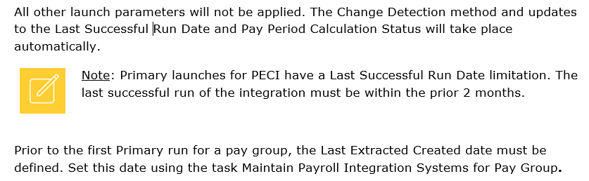
PECI Primary Integration Runs
For PECI, separate integration systems are not required for Primary and Ad-hoc integration launches. Configure one integration system that includes all requirements and use it for both Primary and Ad-hoc launches. When defining a schedule for Primary integration runs, configure the launch parameters as follows:
Notes:
updated

Slide 10

PECI Ad-Hoc Integration Runs
Leave the Primary Run box blank to run the integration as ad-hoc. The Change Detection, Last Successful Run Date, and Pay Group Members launch parameters will be applied.
The Pay Period Calculation Status will not be updated and the Last Successful Run Date will not be saved for the Pay Groups defined.
Notes:
updated

Slide 11
PECI XML Output Structure
Worker
Worker Summary
Effective Change Sequence
Derived Event Code
Effective Moment
Entry Moment
Impacted Data Sections
Notes:
updated

Slide 12
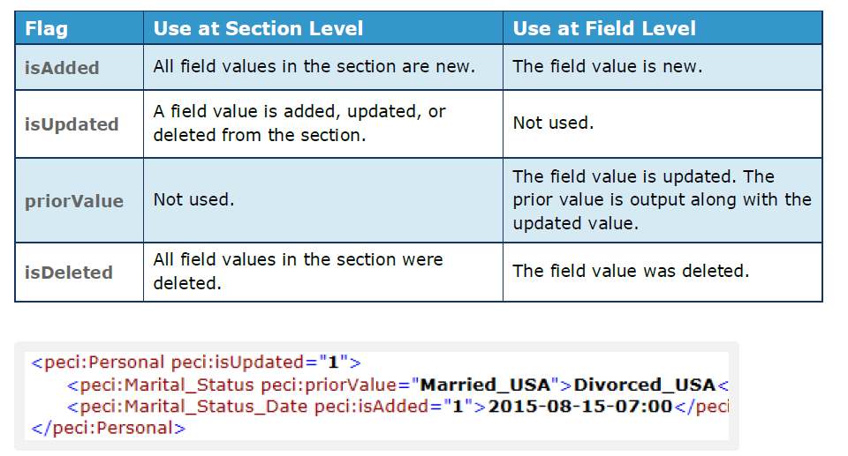
PECI XML Output Change Flags
Notes:
updated

Slide 13
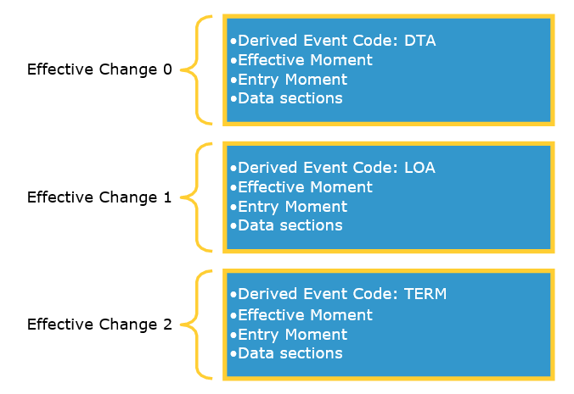
PECI Changes Output
While the change detection method is the same for PI and PECI, the changes reported in the output differ. For PECI, all staffing events and data changes are returned, rather than just the most recent. PI captures one staffing event per worker while PECI captures multiple events per worker and reports the changes in sequence along with an Event Code.
Full Snapshots do not return the Effective Stack. Data effective as of the last day of the defined pay period will be output for each worker.
Notes:
updated

Slide 14
PECI Events Tracked
Staffing Event Code | Definition | Status Event Date | Data Included
CONT-LOA | Continuous leave of absence. A worker returns from leave and immediately goes on leave again. The leave must be back-to-back and can be any type of leave. Example: a worker returns from parental leave on the 15th and goes on personal leave on the 16th. | Same date as original leave effective date | Leave of Absence section
DTA | Other data changes | Effective date of data changes | Changed sections only
HIR | New hire into a pay group | Hire date | All sections for employee
HIR-R | Rescind the new hire event. | Hire date | Status section
LOA | On leave of absence | First day of leave | Status and Leave of Absence sections
LOA-C | Correction to end date or type of leave of absence | Day of return from leave | Status and Leave of Absence sections
LOA-R | Rescind leave of absence | First day of leave | Status and Leave of Absence sections
ORG | Change organization but don’t change pay group | Date of position change | All sections for employee
PCI | Transfer into this pay group from a pay group in a different payroll company | Date of pay group reassignment | All sections for employee
PCO | Transfer out of this pay group to a pay group in a different payroll company | Date of pay group reassignment | Personal, Person Identification, Status, Position, Compensation, Compensation Plans, Benefits Earnings & Deductions, Compensation Earnings & Deductions, Payroll Input Earnings & Deductions
Notes:
updated

Slide 15
PECI Events Tracked
Staffing Event Code | Definition | Status Event Date | Data Included
PGI | Transfer into this pay group from another pay group in the same payroll company | Date of pay group reassignment | Personal, Person Identification, Status, and Position sections
PGO | Transfer out of this pay group to another pay group in the same payroll company | Date of pay group reassignment | Personal, Person Identification, Status, and Position sections
RFL | Return from leave of absence. | First day back at work | Status and Leave of Absence sections
RFL-R | Correction to end date of leave of absence. | First day back at work | Status and Leave of Absence sections
TERM | No longer employed. Employee status changes from active to terminated. | Termination date | Personal, Person Identification, Status, Position, Compensation, Compensation Plans, Benefits Earnings & Deductions, Compensation Earnings & Deductions, Payroll Input Earnings & Deductions
TERM-C | Correct termination event. Correcting the termination date by moving it to an earlier effective date generates this event. Status changes from active to terminated. | Termination date | Status section
TERM-R | Rescind the termination event. Correcting the termination date by moving it to a future effective date generates this event. Status changes from terminated to active. | Termination date | Status section
Notes:
updated

Slide 16
Day 3 Activities #1 - #9

Slide 17

About Deloitte Deloitte refers to one or more of Deloitte Touche Tohmatsu Limited, a UK private company limited by guarantee (“DTTL”), its network of member firms, and their related entities. DTTL and each of its member firms are legally separate and independent entities. DTTL (also referred to as “Deloitte Global”) does not provide services to clients. Please see www.deloitte.com/about for a detailed description of DTTL and its member firms. Please see www.deloitte.com/us/about for a detailed description of the legal structure of Deloitte LLP and its subsidiaries. Certain services may not be available to attest clients under the rules and regulations of public accounting. Copyright © 2016 Deloitte Development LLC. All rights reserved. 36 USC 220506 Member of Deloitte Touche Tohmatsu Limited

